Slide 1

Cyclistic Marketing Strategy: Converting Casual Riders to Annual Members
Presented by: Nitish, Junior Data Analyst
Core Question: "How do Annual Members and Casual Riders use Cyclistic bikes differently?"
Actionable Goal: "Design a strategy to convert the 9% Casual Rider base into profitable Annual Members."

Slide 2
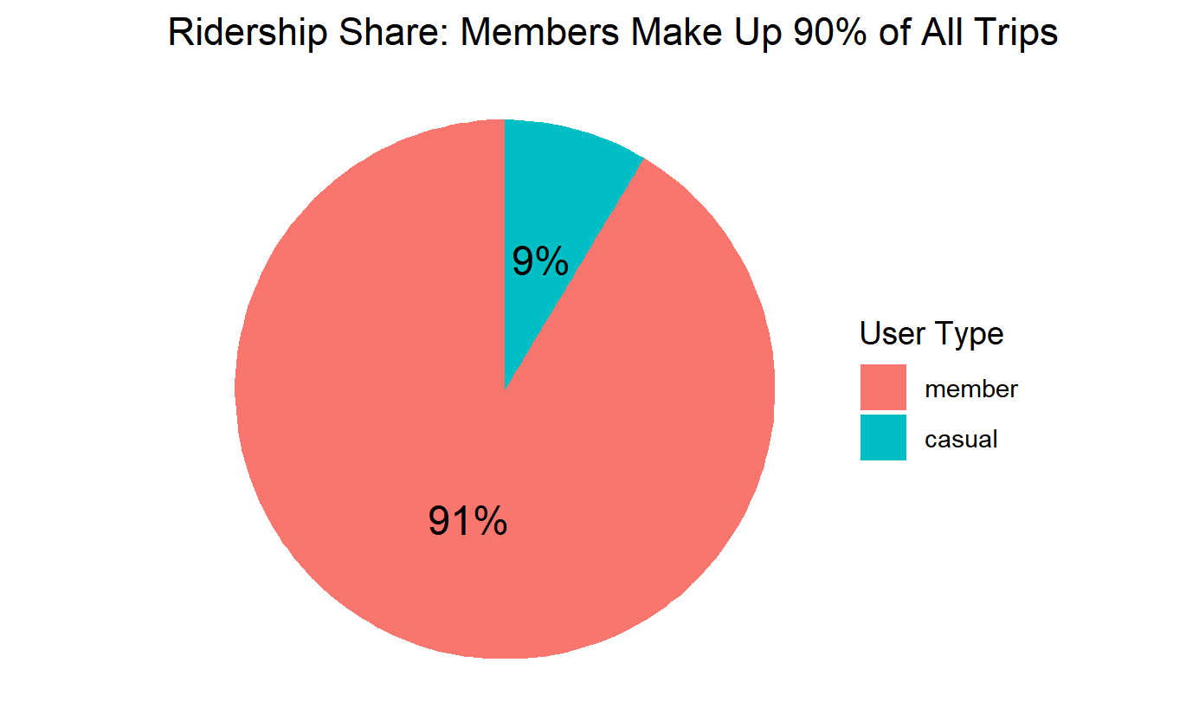
Casuals are our Growth Opportunity (9% Market Share)
Annual Members drive the volume (91%), but future growth is locked in the small 9% Casual segment.

Slide 3
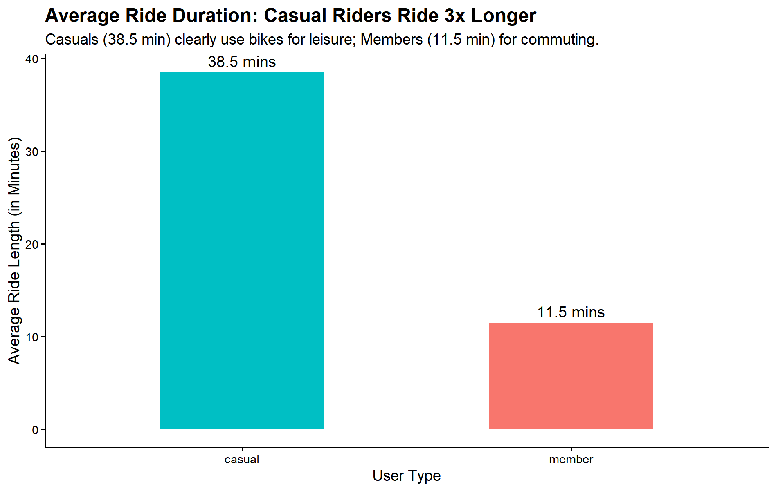
Casual Riders Use Bikes 3X Longer (Leisure vs. Commute)
Casuals: Average ride length 38.5 minutes. (Leisure)
Members: Average ride length 11.5minutes. (Commute)
Casuals fear overage fees on their 30 minute average trips.​

Slide 4
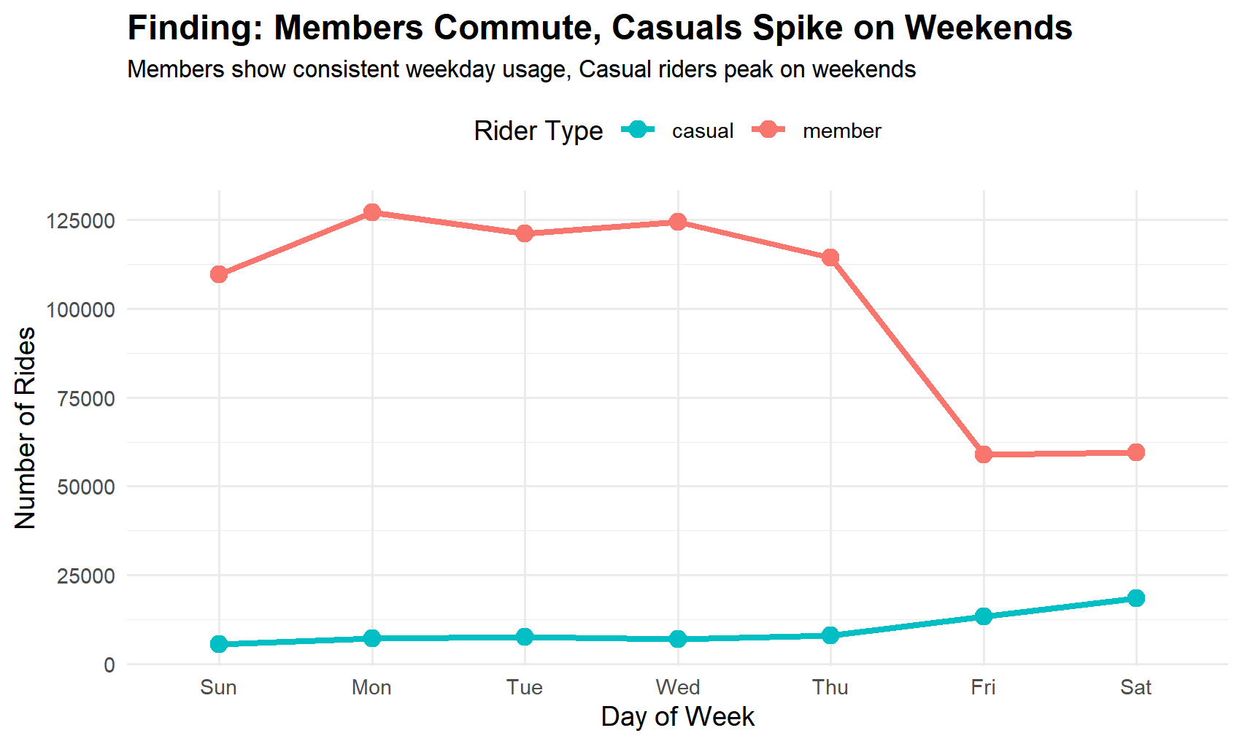
Usage Pattern: Casuals Dominate Weekends
Member usage is high and flat on weekdays; Casual usage spikes on Fridays and Saturdays.
We must launch marketing campaigns focused on weekend usage and leisure activities.

Slide 5
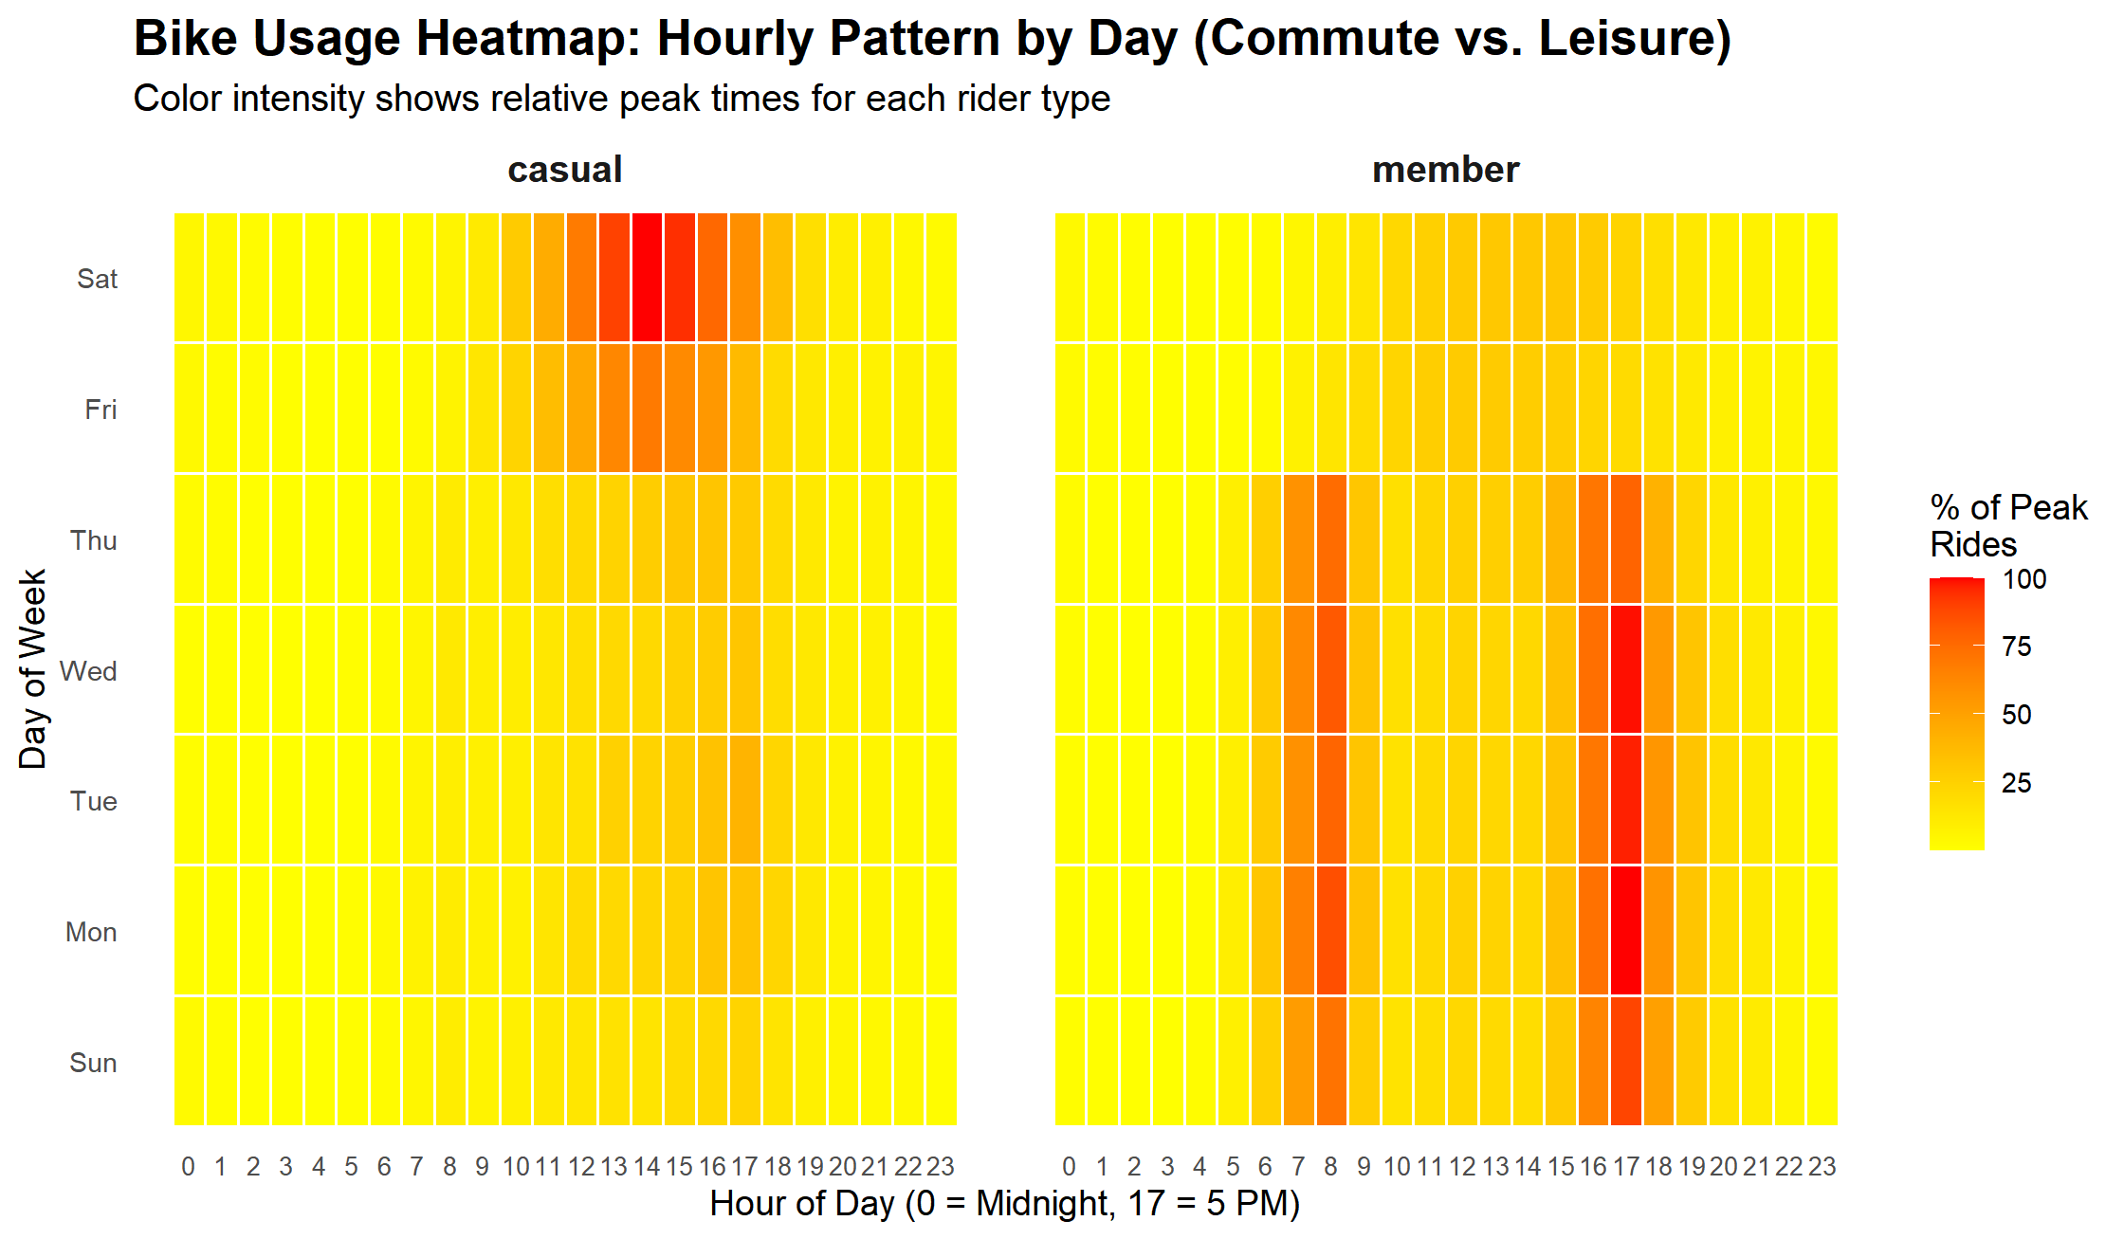
Mid-Day & Weekend are Prime Conversion Times
Members ride during 7 AM−9 AM (Rush Hour), while Casuals ride during 11 AM−3 PM (Leisure Hours).
Advertising budget must be moved away from traditional rush hour slots.

Slide 6
Strategy: Converting Leisure Users into Members
1. Launch the "Weekend Warrior" Plan (Strategy: Target Casuals' weekend spike).
2. Introduce the Extended Ride Benefit (45 Minutes Free) (Strategy: Eliminate the 32 minute average user's overage fee anxiety).
3. Execute Mid-Day Digital Advertising Blitz (Strategy: Focus ads on 11 AM−3 PM slots, where leisure usage peaks).

Slide 7
Final Summary & Next Steps
Summary: Our strategy directly targets the Casual Rider's duration anxiety and leisure habits.
Next Step: A/B Test the 45-minute Extended Ride Benefit against the current 30-minute limit to measure direct conversion impact.

